Slide 1


My First Project Post PhD!
Harry Robertson
Sydney Precision Data Science Centre,
School of Mathematics and Statistics, University of Sydney

Slide 2
Not another transplant talk??
No.
Pregnancy is a complicated process with maternal, placental and fetal factors determine pregnancy outcomes.
Fetal growth restriction (FGR) affects ~5% of pregnancies.
FGR increases risk of stillbirth, neonatal complications, and long-term disease.
Better biomarkers could guide timely interventions and reduce preventable harm.

Slide 3
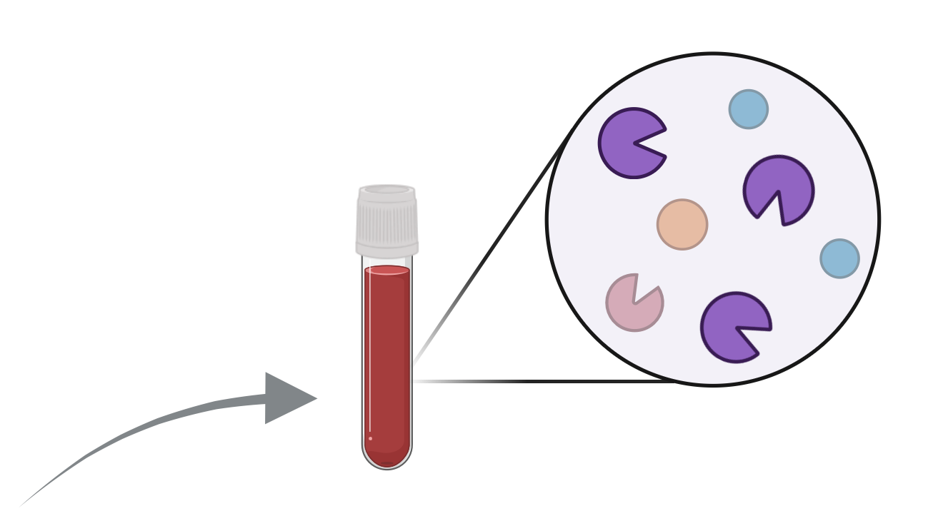
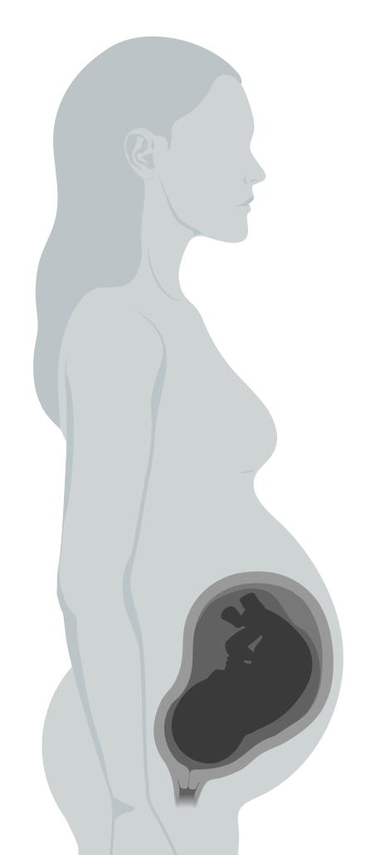
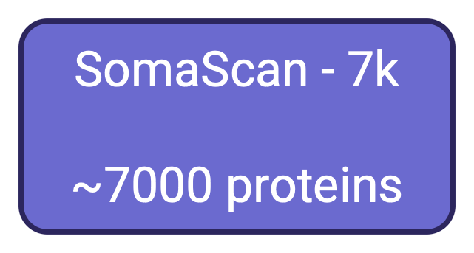


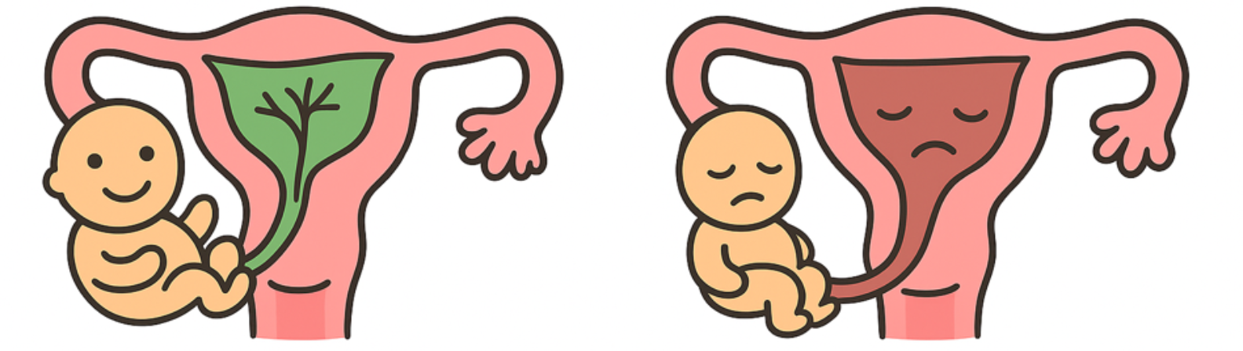
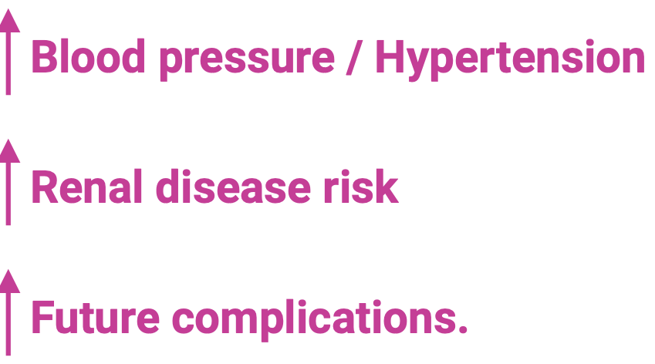
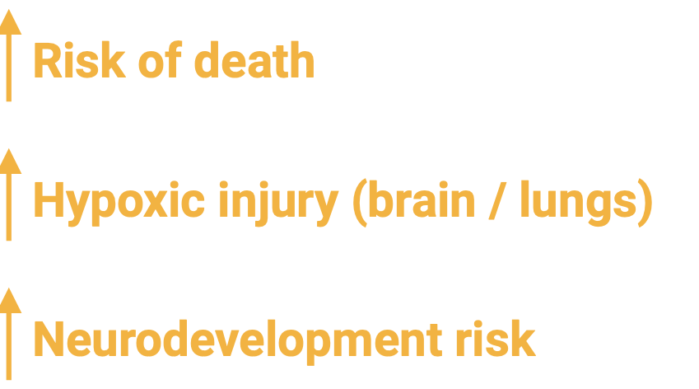

Slide 4
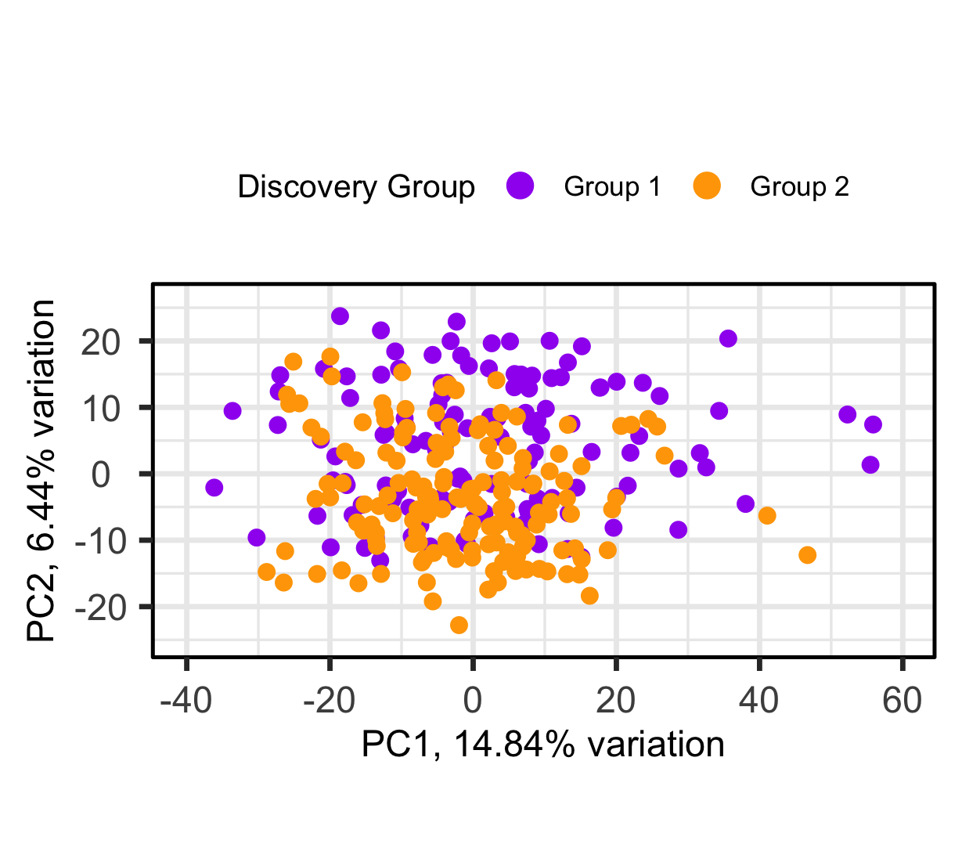
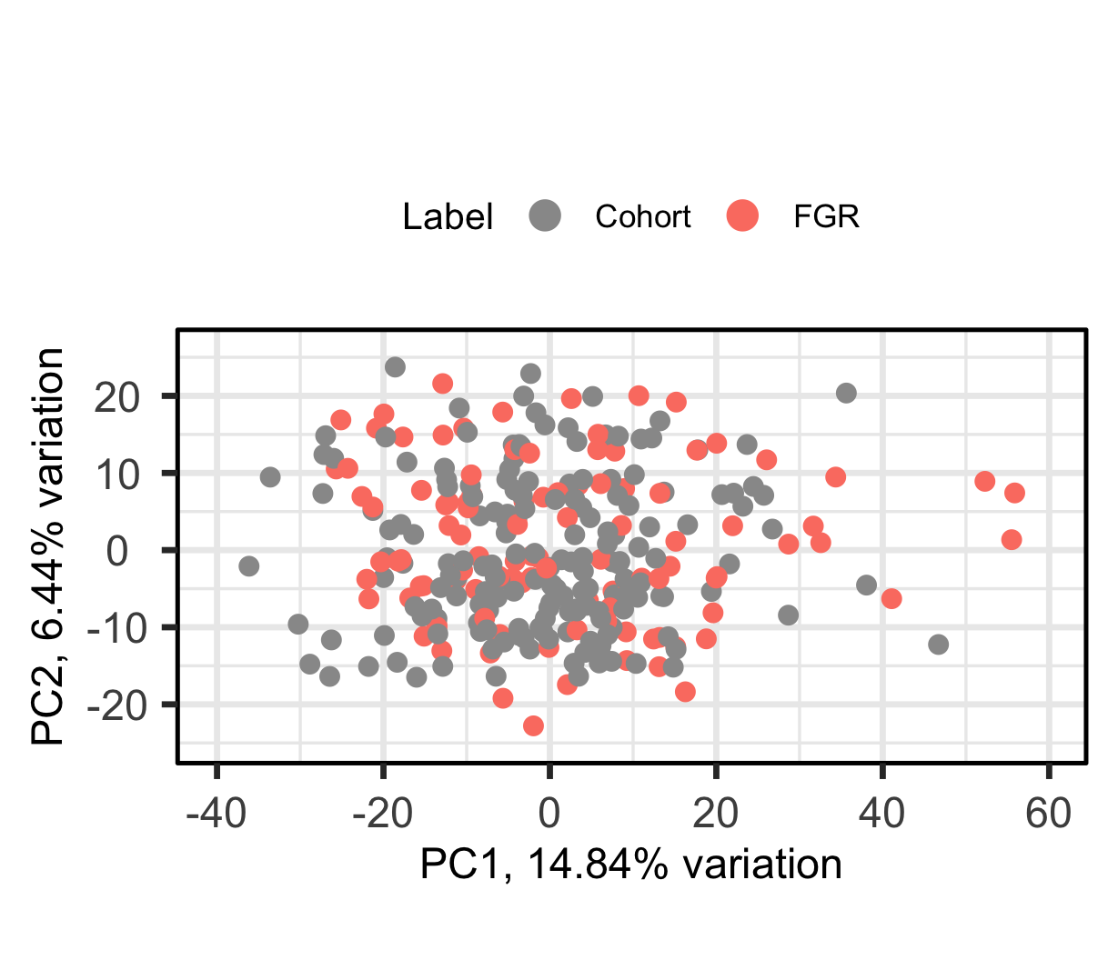
Cohort 1 & 2
Collaborator’s data arrived in two batches (1 & 2).
No biological reason for which cohort a sample was assigned to.
Cohort 1 (n = 126), Cohort 2
(n = 156).
Our goal is to use cohort 1 as discovery and cohort 2 as validation.

Slide 5
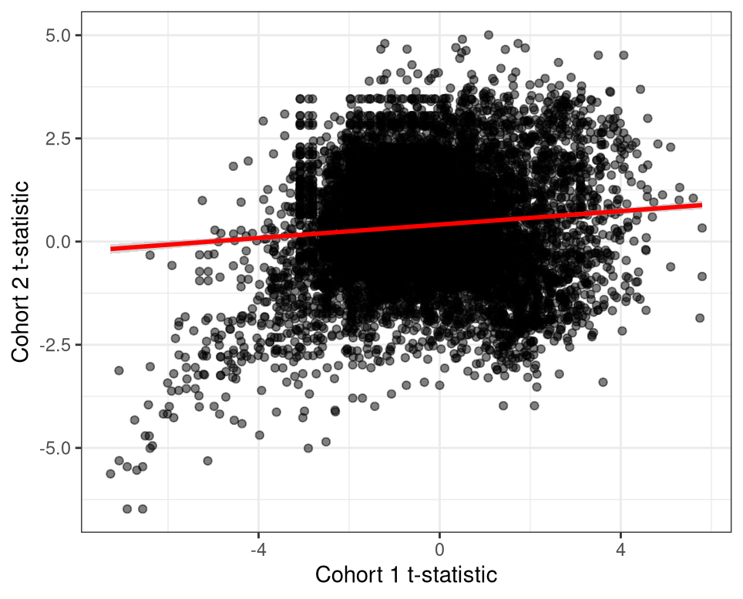
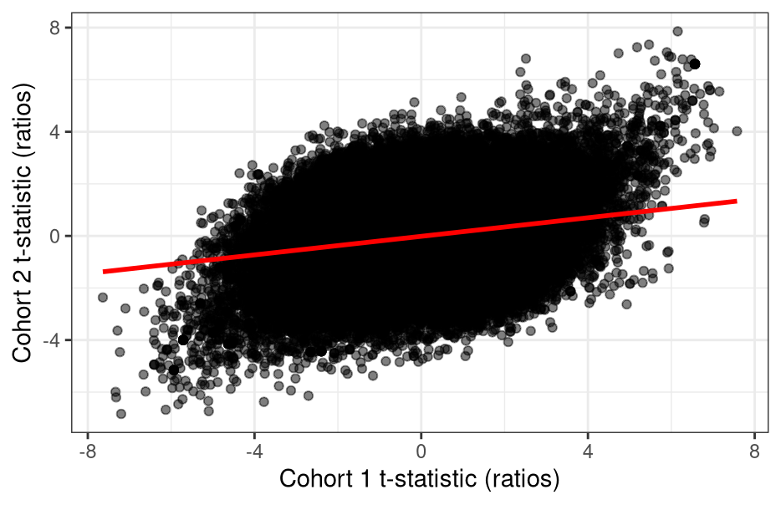
Transferability
Our aim is to develop a transferable classifier on cohort 1.
Let’s compare a t-statistic of each gene across cohorts.
We can see some common features but largely no strong relationship.
CPOP/TOP show that ratios might aid transferability.

Slide 6
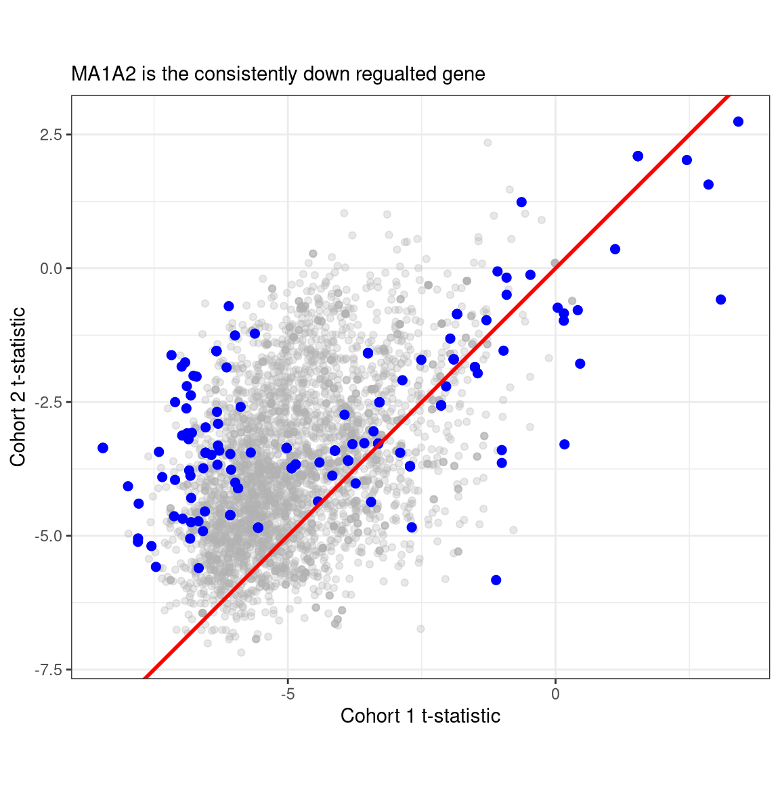
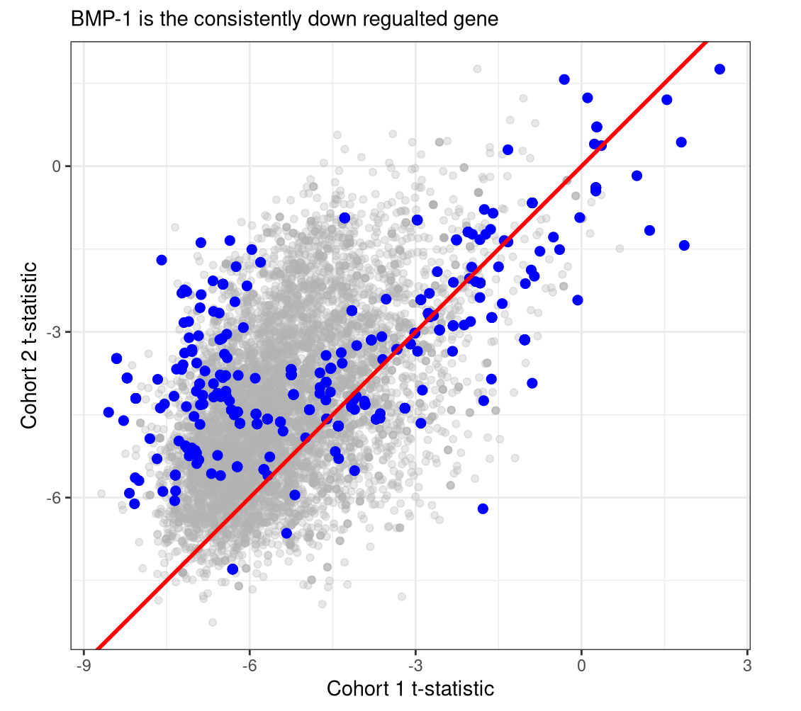
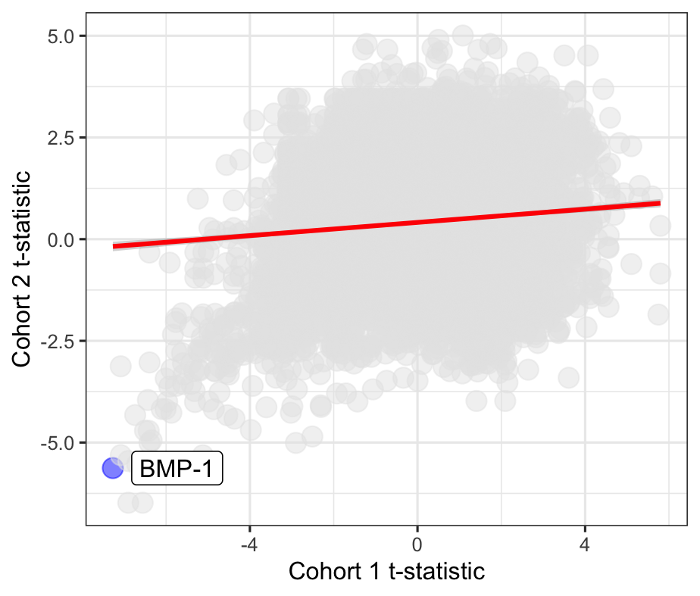
Initial feature selection.
7000 features is too large for ratios. So, we need initial filters.
BMP-1 is a protein consistently down in FGR across both cohorts.
Grey = t-statistic of all ratios with BMP-1 as the numerator.
Blue = features that would’ve been selected from cohort 1.

Slide 7
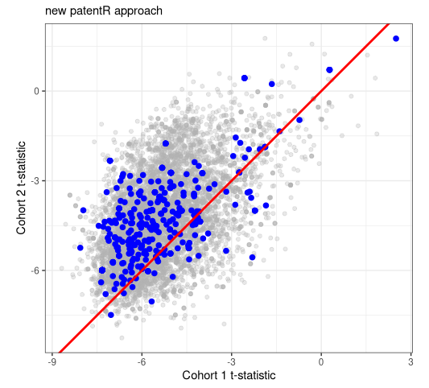
Selecting feature for ratio construction
Taking the top n features and computing the pairwise ratios might miss transferable signal.
Limma gives us the most changing genes by t-statistic.
Stable genes are defined by low t-statistic, and low SE.

Slide 8
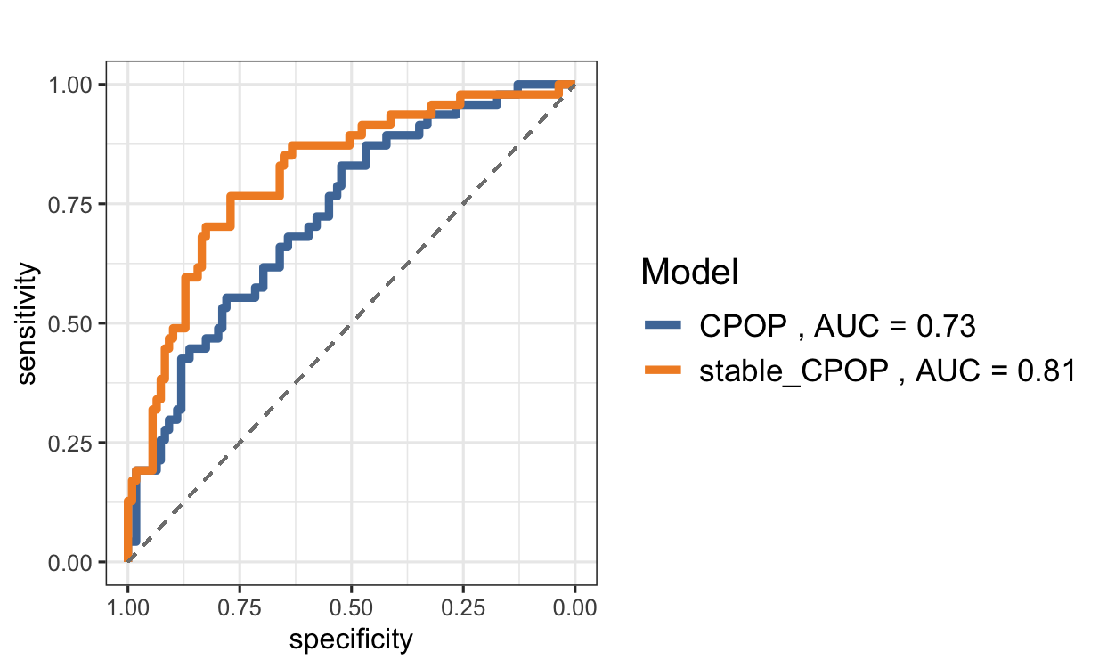
Selecting feature for ratio construction
We can just split cohort 1 by PC1
CPOP on the two pseudo-cohorts.
Just swap out the feature selection (limma) with this new (limma + stable genes)
CPOP does a ton better.

Slide 9
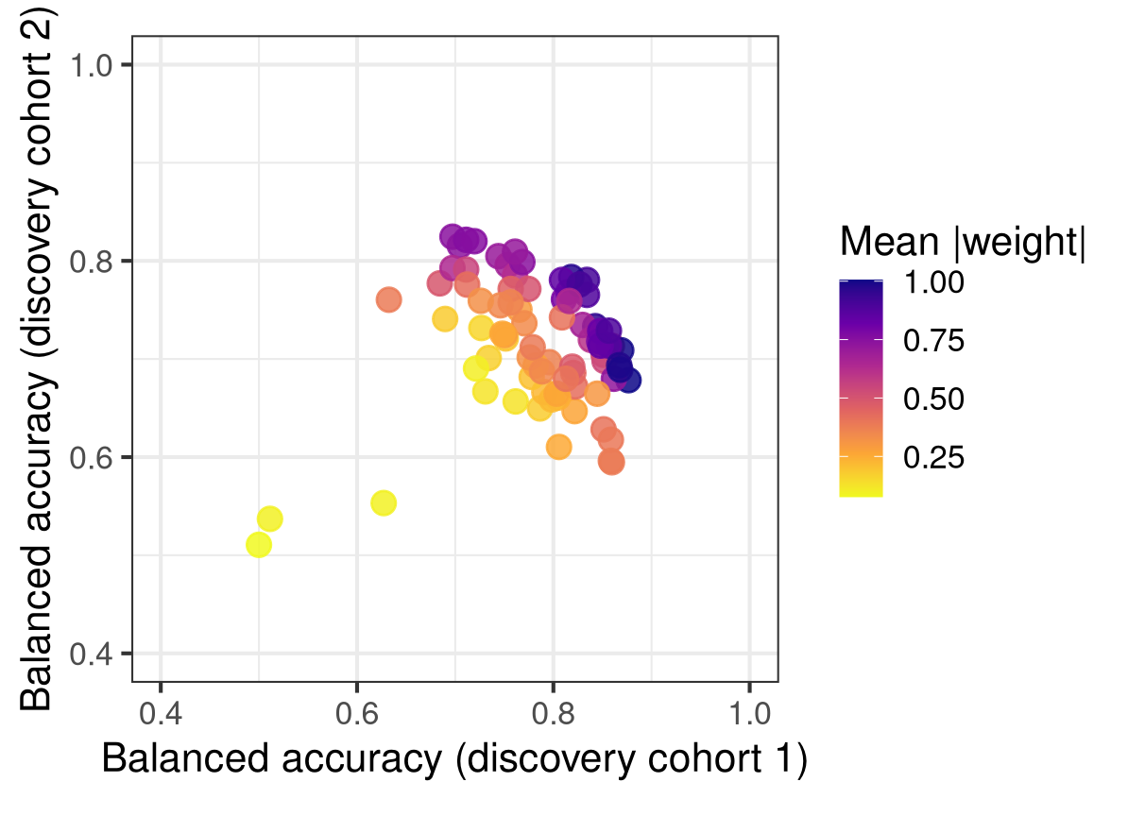
Multi Objective Optimization
We want biomarkers to have certain characteristics related to their use.
A rule out test like ”could this patient potentially have cancer” should have high sensitivity.
A confirmatory diagnosis like ”HIV diagnosis” should have a high specificity.
But what if we wanted to prioritize something abstract like commercialization??

Slide 10

What makes features patentable?
You tell people how it works; in return you exclude others from using it.
Novelty – Biomarkers need to have not been disclosed in exact combination before.
Non-obvious – “Someone skilled in the art” could not come to this conclusion. (stops meta-analysis)
Reproducible - “Someone skilled in the art” should be able to verify your claims. (stops overreach)

Slide 11

Issues with feature selection
When trying to patent a set of genes. You need to smallest number (2-5).
If I have a 5 gene panel, but someone uses 4 of those, that is ok.
However, we know that there is a lot of collinearity in expression data.
(CXCL9 exprs = CXCL10 exprs)

Slide 12
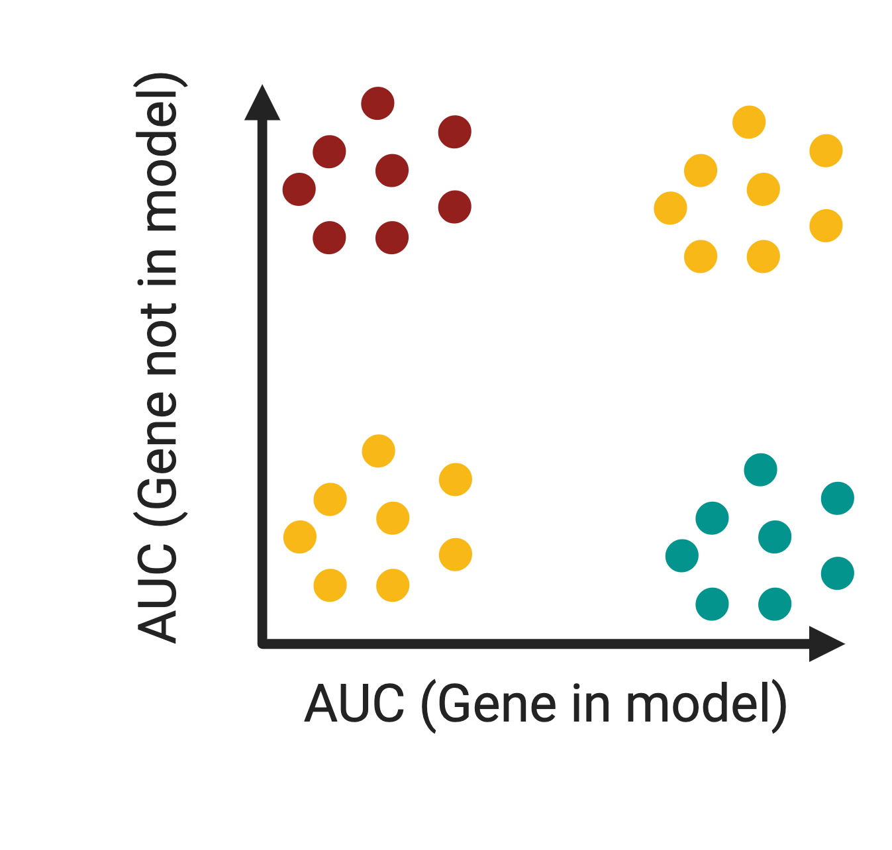
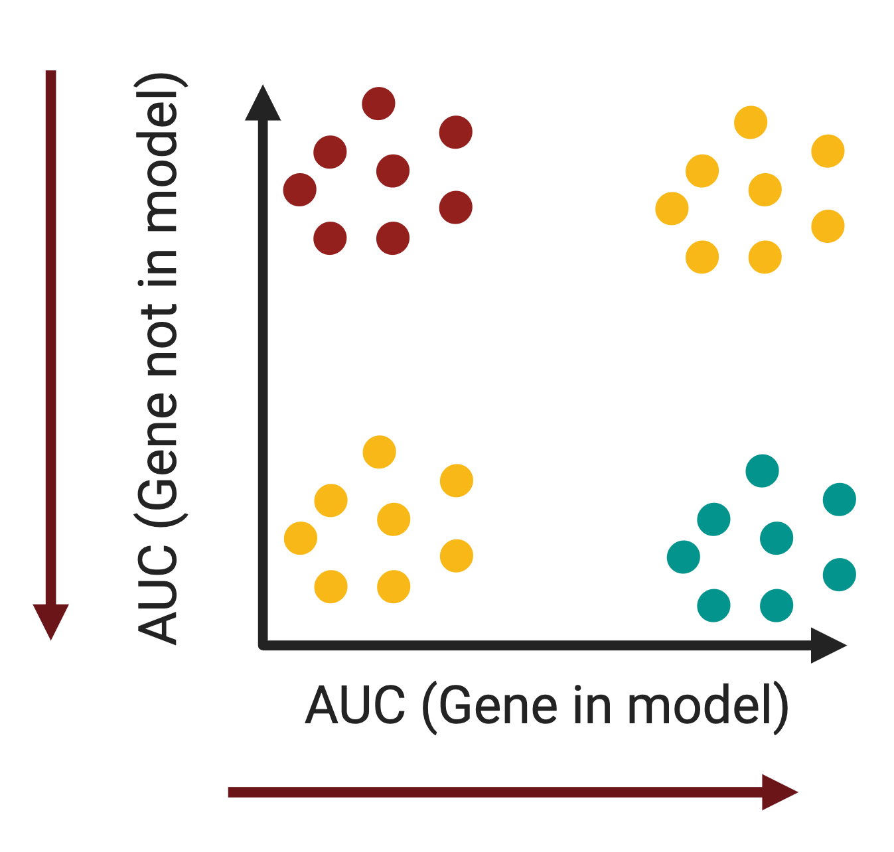
So what can we do?
Current statistical approaches explore what genes are most important to diagnose a condition.
But really, we want to know what genes are critical for model building.
I.e. what gene X is needed to build good models. But if absent, no model can be built.

Slide 13
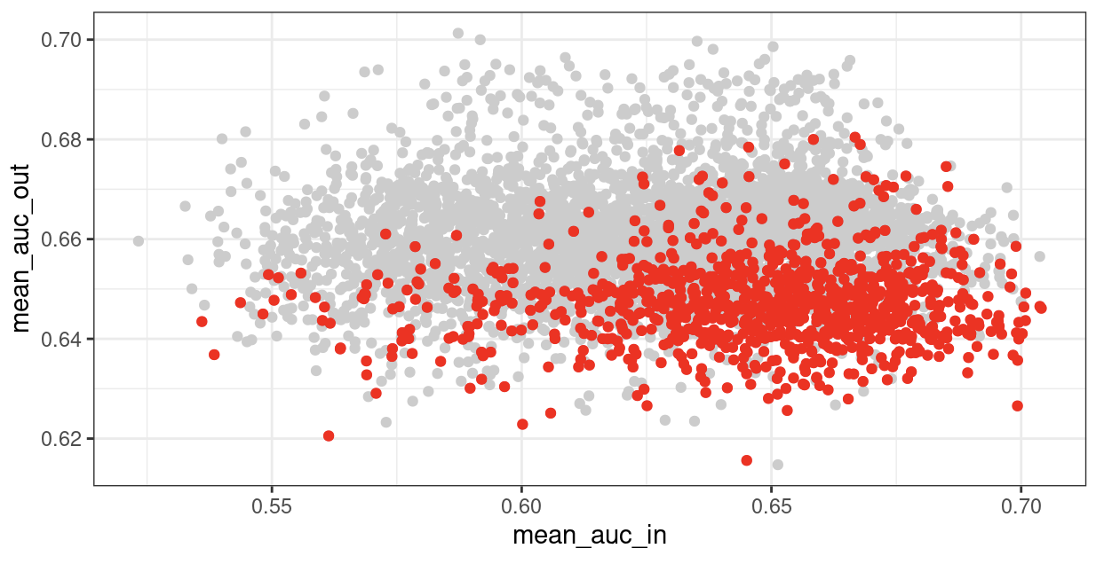
Critical Features
Current statistical approaches explore what genes are most important to diagnose a condition.
But really, we want to know what genes are critical for model building.
I.e. what gene X is needed to build good models. But if absent, no model can be built.

Slide 14
More to come soon!!

Slide 15
Thanks! :)

